Slide 1
Protein comparison

Slide 4
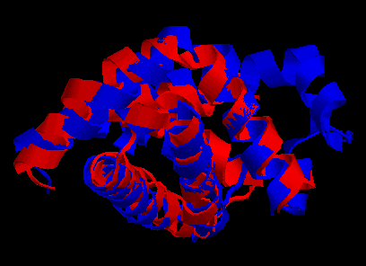
Structure superimposition
Sperm Whale Mioglobin vs bacterial Emoglobin

Slide 5
Structure superimposition problem
A
Correspondence set
B
RMSD or other distance measures
G(B)

Slide 6
Formalizing the structure superimposition problem
Given two sets of points A = (a₁, a₂, …, a_{n}) and B = (b₁,b₂,…b_{m}) in Cartesian space, find the optimal subsets A(P) and B(Q) with |A(P)| = |B(Q)|, and find the optimal rigid body transformation G between the two subsets A(P) and B(Q) that minimizes a given distance metric D over all possible rigid body transformation G, i.e.
where, usually, D is
The two subsets A(P) and B(Q) define a “correspondence”, and
p = |A(P)| = |B(Q)| is called the correspondence length. Naturally, the correspondence length is maximal when A(P) and B(Q) are similar.
Therefore there are essentially two problems in structure alignment:
(i.) Find the correspondence set (which is NP-hard), and
(ii.) Find the alignment transform (which is O(n)).
Phil Bourne 2012

Slide 7
Structural superimposition induces a
structural alignment beween the sequences
C
V
1
C
C
A
V
V
P
T
P
P
P
A
A
R
C
V
T
D
R
D
V
2
A
P
V
P
Induced alignment
VC---PVT
ACRDVPAP
.*...*..
Alignment lenght=8 res
Alignment identity = 2/8

Slide 8
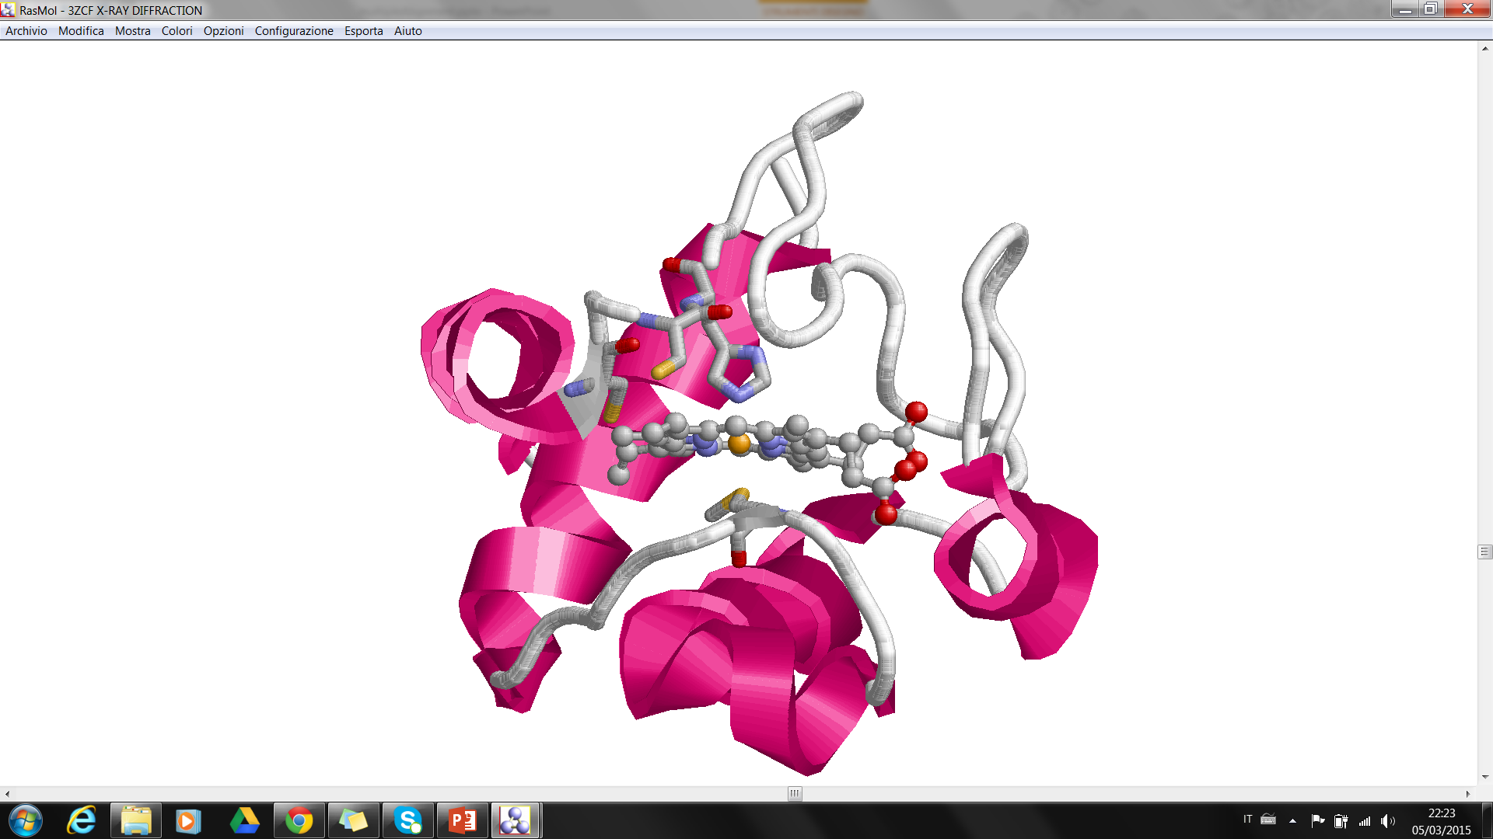
Sequence-to-structure relation: Cytochrome C
Electron carrier protein. The oxidized form of the cytochrome c heme group can accept an electron from the heme group of the cytochrome c1 subunit of cytochrome reductase. Cytochrome c then transfers this electron to the cytochrome oxidase complex, the final protein carrier in the mitochondrial electron-transport chain.
CYS 18
HIS 19
CYS 15
MET 81
UniProt: P99999
Feature key | Position(s) | Length | Description
Binding site^{i} | 15 – 15 | 1 | Heme (covalent)
Binding site^{i} | 18 – 18 | 1 | Heme (covalent)
Metal binding^{i} | 19 – 19 | 1 | Iron (heme axial ligand)
Metal binding^{i} | 81 – 81 | 1 | Iron (heme axial ligand)
PDB: 3zcf:A

Slide 9
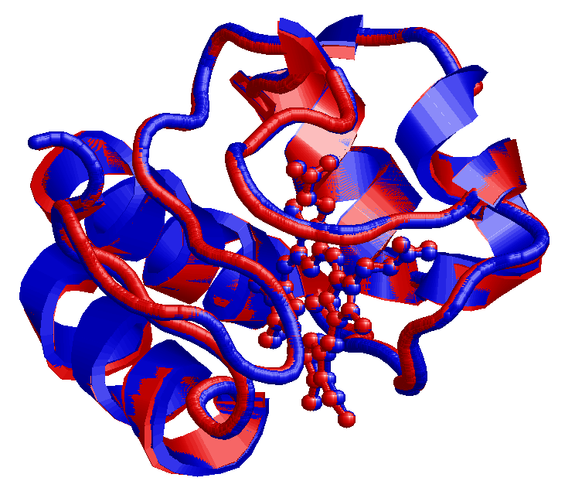
Cytochrome C (Homo vs. Horse)
Human Cytochrome C - Uniprot:P99999. PDB: 3ZCF:A
Equine Cytochrome C – Uniprot: P00004. PDB 3O20:A
Structural alignment:
RMSD= 0,035 nm
1:A 20:A 40:A 60:A
| | . | . | . | . | . | . |
GDVEKGKKIFIMKCSQCHTVEKGGKHKTGPNLHGLFGRKTGQAPGYSYTAANKNKGIIWGEDTLMEYLEN
||||||||||:.||.||||||||||||||||||||||||||||||:.||.|||||||.|.|:||||||||
GDVEKGKKIFVQKCAQCHTVEKGGKHKTGPNLHGLFGRKTGQAPGFTYTDANKNKGITWKEETLMEYLEN
| | . | . | . | . | . | . |
1:A 20:A 40:A 60:A
80:A 100:A
. | . | . |
PKKYIPGTKMIFVGIKKKEERADLIAYLKKATNE
||||||||||||.|||||.||.||||||||||||
PKKYIPGTKMIFAGIKKKTEREDLIAYLKKATNE
. | . | . |
80:A 100:A
88% sequence identity

Slide 10
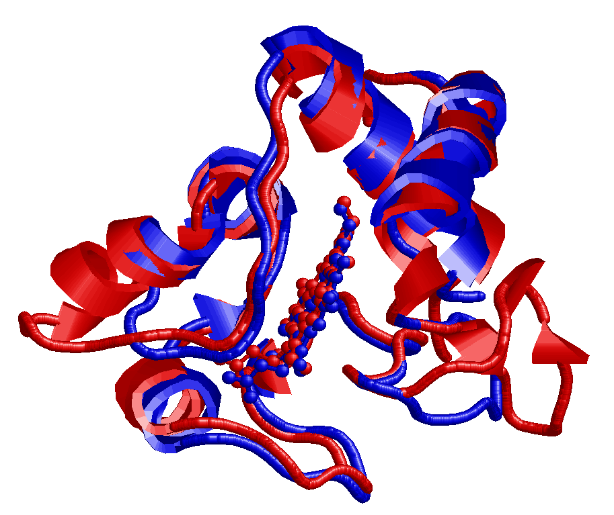
Cytochrome C (Homo vs. Rhodobacter sphaeroides)
Human Cytochrome C - Uniprot:P99999. PDB: 3ZCF:A
Cytochrome C2 Rhodobacter Sph. – Uniprot: P0C0X8. PDB 1CXC:A
Structural alignment:
RMSD= 0,18 nm
1:A 20:A 40:A
| | . | . | . | . | .
GDVEKGKKIFIMKCSQCHTVEKGG-------KHKTGPNLHGLFGRKTGQAPGYS-YTAANKNKG---IIW
||.|.|.|.|. .|..||.:.... ..||||||:|..||..|....:. |....|..| :.|
GDPEAGAKAFN-QCQTCHVIVDDSGTTIAGRNAKTGPNLYGVVGRTAGTQADFKGYGEGMKEAGAKGLAW
| | . | . | . | . | . | . |
3:A 20:A 40:A 60:A
60:A 80:A 100:A
| . | . | . | . |
GEDTLMEYLENPKKYI--------PGTKMIFVGIKKKEERADLIAYLKKATNE
.|:...:|.:.|.|:: ...||.| .:||..:...:.|||......
DEEHFVQYVQDPTKFLKEYTGDAKAKGKMTF-KLKKEADAHNIWAYLQQVAVR
. | . | . | . | . |
80:A 100:A 120:A
28% sequence identity

Slide 11
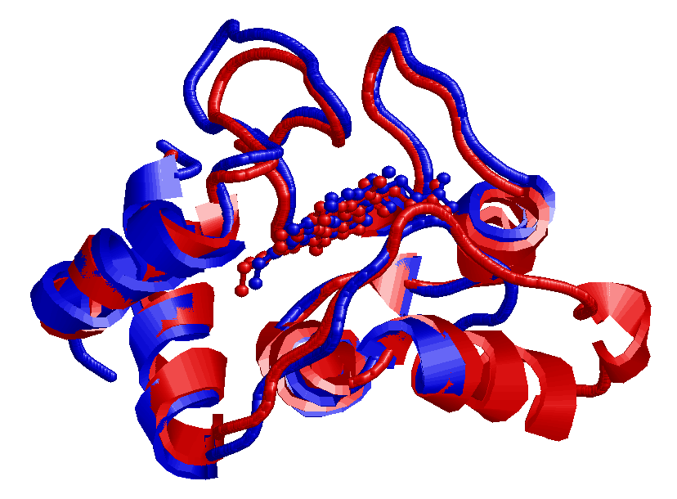
Cytochrome C (Homo vs. Rhodopseudomonas palustris)
Human Cytochrome C - Uniprot:P99999. PDB: 3ZCF:A
Cytochrome C2 Rhodopseudomons pal. – Uniprot: P00091. PDB 1I8O:A
Structural alignment:
RMSD= 0,13 nm
1:A 20:A 40:A 60:A
| | . | . | . | . | . | .
GDVEKGKKIFIMKCSQCHTVEKGGKHKTGPNLHGLFGRKTGQAPGYSYTAANKNKG---IIWGEDTLMEY
.|...|..:|. .|..||.. .|...||.|.|..|||.|.|.|:.|...|.|.| ::|..|.:..|
xDAKAGEAVFK-QCMTCHRA---DKNMVGPALAGVVGRKAGTAAGFTYSPLNHNSGEAGLVWTADNIVPY
| | . | . | . | . | . | .
1:A 20:A 40:A 60:A
80:A 100:A
| . | . | . |
LENPKKYIP--------------GTKMIFVGIKKKEERADLIAYLKKAT
|..|..::. .|||.| .:...::|.|.:|||....
LADPNAFLKKFLTEKGKADQAVGVTKMTF-KLANEQQRKDVVAYLATLK
| . | . | . | . |
80:A 100:A
29% sequence identity

Slide 12
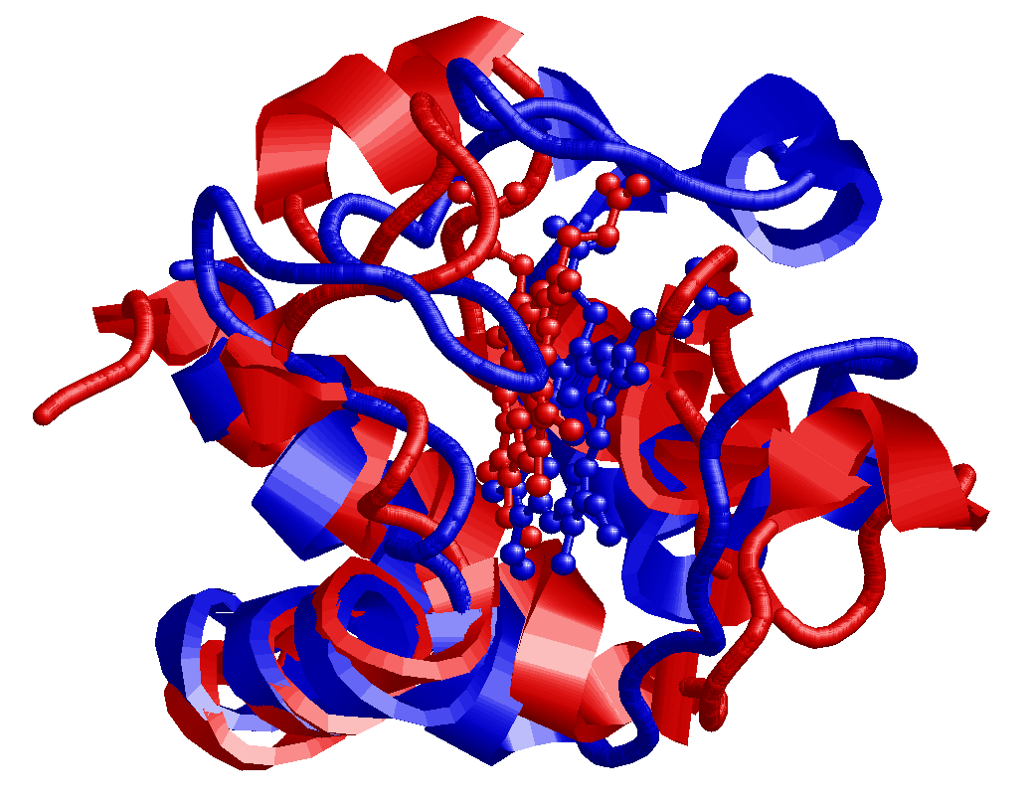
Cytochrome C (Homo vs. Arabidopsis thaliana)
Human Cytochrome C - Uniprot:P99999. PDB: 3ZCF:A
Cytochrome C6A Arabidopsis Thaliana – Uniprot: Q93VA3. PDB 2CE0:A
Structural alignment:
RMSD= 0,35 nm
1:A 20:A 40:A 60:A
| | . | . | . | . | . | .
GDVEKGKKIFIMKCSQCHTVEKGGKHKTGP---NLHG-LFGRKTGQAPGYSYTAANKNKGIIWGEDTLME
.|:::|..:|...|..||... |... . .|.. ...|. .:..|:.:..
LDIQRGATLFNRACAACHDTG--GNII--QPGATLFTKDLERN-----------------GVDTEEEIYR
| | . | . | . | . |
3:A 20:A 40:A
80:A 100:A
| . | . | . |
YLE---------NPKKYIPGTKMIFVGIKKKEERADLIAYLKKATNE
... ..|....|.......:... |...|..:.|....:
VTYFGKGRMPGFGEKCTPRGQCTFGPRLQDE-EIKLLAEFVKFQADQ
. | . | . | . | .
60:A 80:A
13% sequence identity

Slide 13
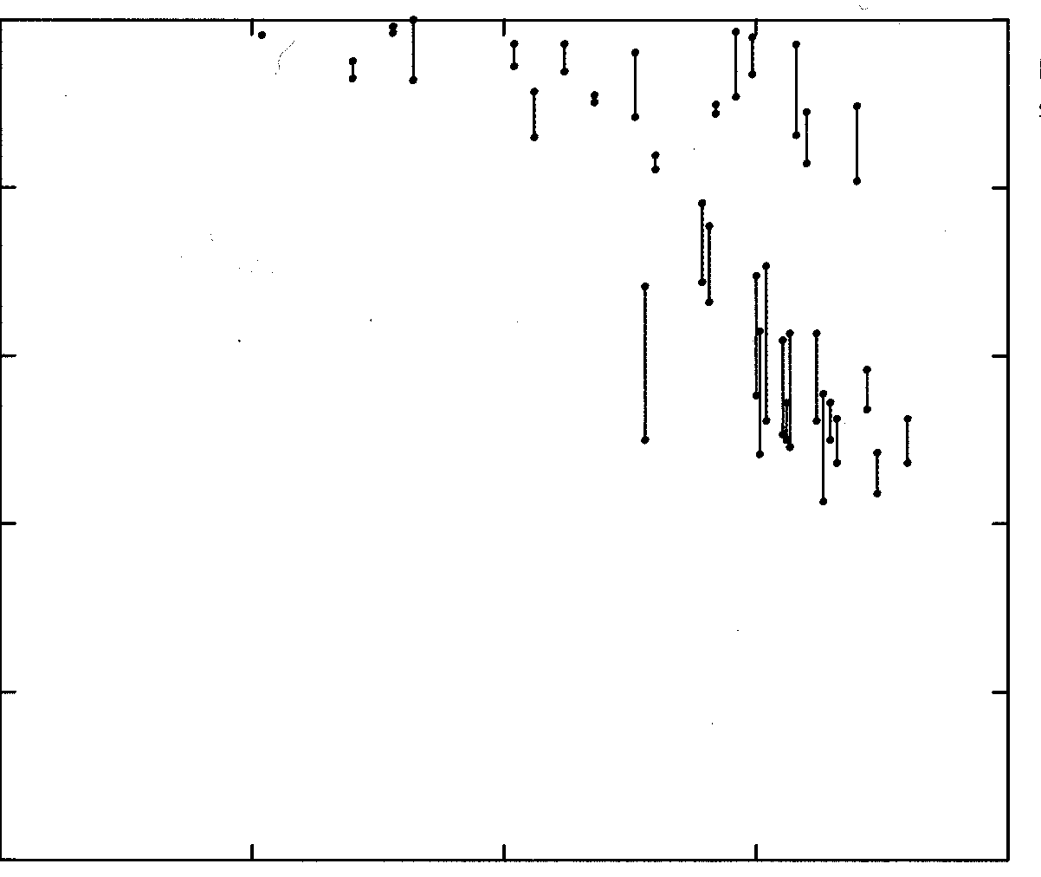
Sequence-to-structure relation
By structurally aligning a large set of strucures:
2.5
1.0
2.0
0.8
1.5
0.6
Fraction of residues in core with RMSD < 0.1 nm
Rmsd of backbone atoms in core
1.0
0.4
0.5
0.2
0.0
0.0
100
50
0
100
50
0
Percent identical residues in core
Percent identical residues in core
Proteins more than 60% identical have more than 90% of residues that result less than 0.1 nm apart after superimposition
Chothia, C. & Lesk, A. M. (1986). The relation between the divergence of sequence and structure in proteins. EMBO J. 5, 823-826.

Slide 14
Sequence-to-structure relation
By structurally aligning a large set of strucures:
1
0
0
.
i
d
e
n
t
i
t
y
8
0
Sequence identity imply structural identity
6
0
Sequence identity (%)
4
0
Sequence
identity DO NOT
Imply structural similarity
2
0
0
0
5
0
1
0
0
1
5
0
2
0
0
2
5
0
No of aligned residues
Rost B (1999). The twilight zone of protein alignments. Protein Engineering 12, 85-94.

Slide 15
Sequence identity and structural similarity
Sequences longer than 100 residues and sharing more the 30% of similar residues have similar structures
For shorter sequences the level of identity must be higher
This DO NOT mean that sequences sharing lower identity MUST have different structures
Example: Sperm Whale Mioglobin and bacterial Emoglobin
RMSD = 0.19 nm, Identity: 14%
.

Slide 16
Evolution did it (?)
Evolution: Variability and Natural Selection
Sequences of living organisms have evolved from ancestral sequences
Genomic sequences are continually changing at random
The environment operates a selection of the individuals on the basis of the fitness of their phenotypes
When the products of the modified gene (the proteins, the structural RNAs ….) fit worse with the environment than the original ones, the individual has a lower probability of surviving and the mutation has lower probability to be transmitted
NB. Are mutation always random? Not, at least when the mutation rate is taken into consideration (Radman polymerases)

Slide 17
Homology vs sequence similarity
Homology
Sequences are homologous when they derive from a common ancestor
Orthologous when they belong to different species
Paralogous when they are present into the same species (duplication)
Similarity
Sequences are similar if they share a large amount of residues along the sequence: it is a comparative criterion, not an evolutionary one.

Slide 18
Homology vs Sequence Similarity
Are homologous sequences always similar?
It depends on how much did they separated after the divergence.
Are similar sequences always homologous?
Different sequences could be evolved in a convergent way towards similar sequences. (Similarly to wings, independently evolved in insects, birds and bats)
In principle, homology and similarity are different concepts. However, sequences sharing high similarity are likely to be homologous.
Similarity can be measured as the degree of identity

Slide 19
Sequence alignment
Comparing sequences (without structures) can give information about the structural similarity among two proteins
Sequence comparison = sequence alignment

Slide 20
Pairwise Sequence Alignment
EEELTKPRLLWALYFNMRDALSSG
VEKPRILYALYFNMRDSSDE
EEELTKPRLLWALYFNMRDALSSG-
---VEKPRILYALYFNMRD--SSDE
Alignment The process of lining up two or more sequences to achieve maximal levels of identity (and conservation, in the case of amino acid sequences) for the purpose of assessing the degree of similarity and the possibility of homology.
Slide by Vered Caspi, BGU. 21.12.2005

Slide 21
Pairwise Sequence Alignment
EEELTKPRLLWALYFNMRDALSSG
VEKPRILYALYFNMRDSSDE
EEELTKPRLLWALYFNMRDALSSG-
---VEKPRILYALYFNMRD--SSDE
end gap
gap
conserved
substitution
mismatch
match
Slide by Vered Caspi, BGU. 21.12.2005

Slide 22
Sequence alignment
In order to define a sequence alignment procedures we must:
To define a score (or a distance) between two aligned sequences
To find an algorithm for finding the alignment with maximum score (or minimal distance)
To statistically evaluate the significance of the alignment

Slide 23
Sequence alignment
In order to define a sequence alignment procedures we must:
To define a score (or a distance) between two aligned sequences
To find an algorithm for finding the alignment with maximum score (or minimal distance)
To statistically evaluate the significance of the alignment

Slide 24
Distance between aligned sequences
Alignment without gaps
A: ALASVLIRLITRLYP
B: ASAVHLNRLITRLYP
The alignment consists of a sequence of paired residues
Defining a score for the substitution of residue i with residue j: s(i,j) [Substitution matrix] ,
the score of the two aligned sequences can be computed as the sum of substitution scores over the alignment length
NB: it assume strong independence among the alignment positions

Slide 25
How to derive substitution scores?
1) Identity matrix
s(i,j) = 1 if i=j
s(i,j) = 0 if i=j
A: ALASVLIRLITRLYP
B: ASAVHLNRLITRLYP
101001011111111
All the mismatches are considered as equivalent
Is it realistic for proteins? For DNA?
Alternatives?

Slide 26
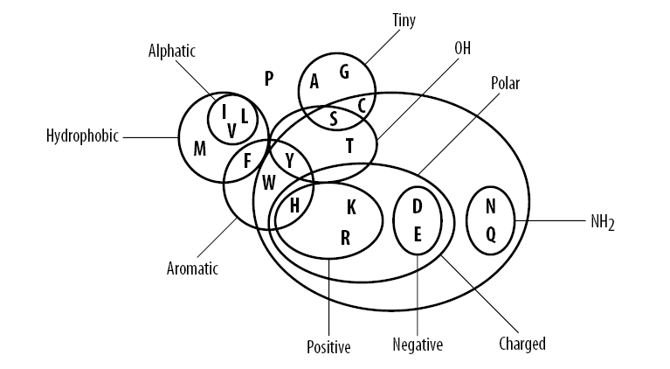
How to derive substitution scores?
1) Physical-chemical characteristics

Slide 27
The similarity of pairs of amino acids (McLachlan, 1971)
A 8.
R 2. 8.
N 3. 3. 8.
D 3. 1. 5. 8.
C 1. 1. 1. 1. 9.
Q 3. 5. 4. 4. 0. 8.
E 4. 3. 4. 5. 0. 5. 8.
G 3. 3. 3. 3. 1. 2. 3. 8.
H 3. 5. 4. 4. 3. 4. 2. 2. 8.
I 2. 1. 1. 0. 1. 0. 1. 1. 2. 8.
L 2. 2. 1. 1. 0. 3. 1. 1. 2. 5. 8.
K 3. 5. 4. 3. 0. 4. 4. 3. 4. 1. 2. 8.
M 3. 1. 2. 2. 3. 3. 1. 1. 3. 5. 6. 1. 8.
F 1. 1. 0. 1. 0. 0. 0. 0. 4. 3. 5. 0. 5. 9.
P 4. 3. 1. 3. 0. 3. 4. 3. 3. 1. 1. 3. 1. 1. 8.
S 4. 4. 5. 3. 2. 4. 4. 3. 3. 2. 2. 3. 2. 2. 3. 8.
T 3. 3. 3. 3. 2. 3. 4. 2. 4. 3. 3. 3. 3. 1. 3. 5. 8.
W 1. 3. 0. 0. 2. 2. 1. 1. 3. 3. 3. 1. 1. 6. 0. 3. 2. 9.
Y 1. 2. 2. 1. 1. 1. 2. 0. 4. 3. 3. 1. 2. 6. 0. 3. 1. 6. 9.
V 3. 2. 1. 1. 1. 2. 2. 2. 2. 5. 5. 2. 4. 3. 2. 2. 3. 2. 3. 8.
A R N D C Q E G H I L K M F P S T W Y V
Score:
Similar pairs have high values

Slide 28
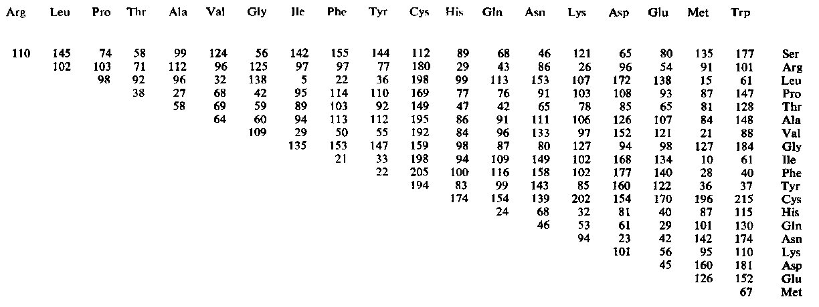
Chemical distance (Grantham, 1974)
Distance:
Similar pairs have low values

Slide 29
3) Substitution scores derived from known structural alignments among proteins
Given a set of good alignments it is possible to estimate the probability of the mutation between any pairs of residues
Given (many) pairs of aligned sequences, we estimate the frequency of substitution i^{A}->j^{B} or i^{B}->j^{A} (independently of the direction): P_{ij}
Ex:
A: ALASVLIRAILRLYP
B: ALAVLLNRLILRALP
P(A,A)=

Slide 30
3) Substitution scores derived from known structural alignments among proteins
Given a set of good alignments it is possible toestimate the probability of the mutation between any pairs of residues
Given (many) pairs of aligned sequences, we estimate the frequency of substitution i^{A}->j^{B} or i^{B}->j^{A} (independently of the direction): P_{ij}
Ex:
A: ALASVLIRAILRLYP
B: ALAVLLNRLILRALP
P(A,A)= N(A^{A},A^{B})/N = 2/15
P(A,L)= P(L,A)=

Slide 31
3) Substitution scores derived from known structural alignments among proteins
Given a set of good alignments it is possible toestimate the probability of the mutation between any pairs of residues
Given (many) pairs of aligned sequences, we estimate the frequency of substitution i^{A}->j^{B} or i^{B}->j^{A} (independently of the direction): P_{ij}
Ex:
A: ALASVLIRAILRLYP
B: ALAVLLNRLILRALP
P(A,A)= N(A^{A},A^{B})/N = 2/15
P(A,L)= P(L,A)= [N(L^{A},A^{B})+N(A^{A},L^{B})]/N = 2/15

Slide 32
How to estimate whether a substitution frequency is significant?
Which is the probability that the substitution i->j is random (and so not significant)?
1st set of known alignments
A: ALASVLIRAILRLYP
B: ALAVLLNRLILRALP
2nd set of known alignments
A: LLLLAALLLALLALL
B: LALLAALLAALLALL
P(A,L) =

Slide 33
How to estimate whether a substitution frequency is significant?
Which is the probability that the substitution i->j is random (and so not significant)?
1st set of known alignments
A: ALASVLIRAILRLYP
B: ALAVLLNRLILRALP
2nd set of known alignments
A: LLLLAALLLALLALL
B: LALLAALLAALLALL
P(A,L) = 2/15 in both the cases.
Are they equally significant?
The probability that the substitution is random depends on the frequency of the two substituted residues P_{i} e P_{j}

Slide 34
Comparison with the independence condition
Random substitution i^{A} -> j^{B} means that the two event:
E₁ = (i in A) and E₂ = (j in B) are INDEPENDENT
The “non-randomness” degree is measured by comparing P_{ij} with the product P_{i}P_{j}
1st set of known alignments
A: ALASVLIRAILRLYP
B: ALAVLLNRLILRALP
P(A)= 6/30, P(L) =10/30
P(A,L) = 2/15 > 1/15 = P(A)P(L): MORE FREQUENT THAN EXPECTED
2nd set of known alignments
A: LLLLAALLLALLALL
B: LALLAALLAALLALL
P(A)= 10/30, P(L) =20/30
P(A,L) = 2/15 < 2/9 = P(A)P(L): LESS FREQUENT THAN EXPECTED

Slide 35
Substitution score
The ratio r_{ij} = P_{ij}/P_{i}P_{j}
determines whether the substitution i -> j is more or less frequent than expected by random.
Given an alignment between two sequences
A: SLDPIKHTYRALMNVDSLRTFPIL
B: SFGIKKHTKLAKLPVDTIKSWPIL
the probability of all the substitutions A->B is computed as the product of the ratios r_{ij} : r_{SS} r_{LF} r_{DG} r_{PI} r_{IK} … (assuming the independence among the positions)
SCORE : s(i,j) =int[K log(P_{ij}/P_{i}P_{j})] LOG-ODD SCORE
Thanks to the logarithm the scores can be added up
Minimal distance = Maximal score

Slide 36
Exercise
Compute the substitution score matrix starting from these alignments
ACAGGTGGACCT
ACTGGTCGACTT
CTATATGG
CCGGATCG

Slide 37
Substitution matrices: PAM
In this framework different matrices can be derived.
The fundamental difference resides in the sets of alignments adopted for building the matrices.
PAM: (Point Accepted Mutation) Margaret Oakley Dayhoff (1972 Atlas of protein sequences and structures)
A point accepted mutation is the replacement of a single amino acid in the primary structure of a protein with another single amino acid, which is accepted by the processes of natural selection.
PAMx: substitution matrix referring to the sequences undergoing x PAMs every 100 residues

Slide 38
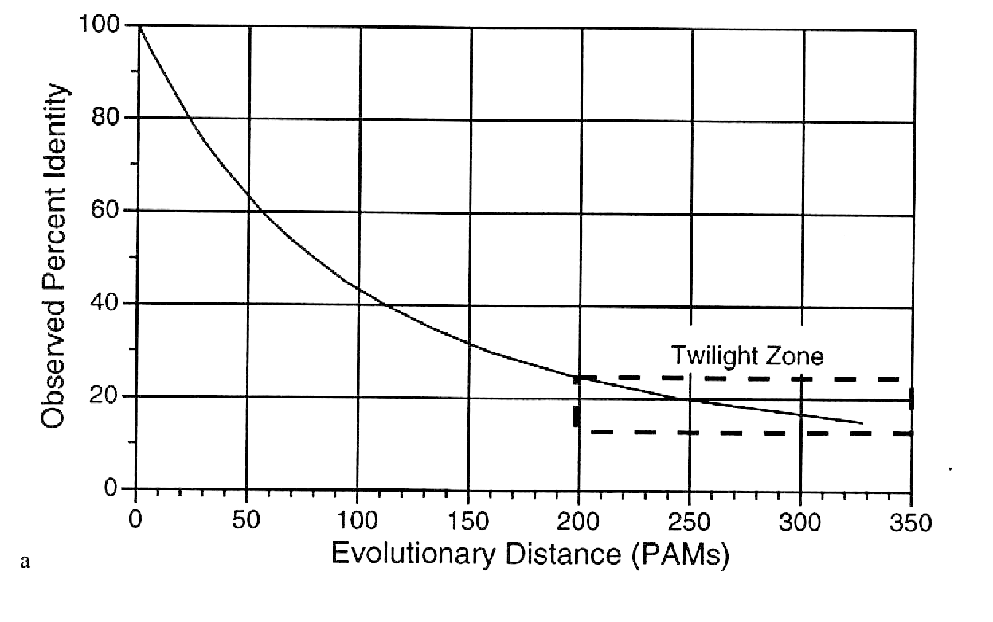
Relationship between the PAM and the identity between two sequences
The number of mutational events (PAM) does NOT correspond to the number of different residues between two sequences, when mutations accumulates.

Slide 39
Substitution matrices: PAM
PAMx: Margaret Oakley Dayhoff (1978)
1,572 changes in 71 groups of closely related proteins (85% min sequence identity)
Original formulation considers manually built phylogenetic trees where hypothetical ancestor sequences are inferred.

Slide 40
Substitution matrices: PAM
PAMx: Margaret Oakley Dayhoff (1978)
1,572 changes in 71 groups of closely related proteins (85% min sequence identity)
General formulation can consider manually built sequence alignments without referring to phylogenesis.
With highly similar sequences, alignments are easily compiled.
Ideally, a conditional probability matrix could be computed using sequences with 1% of mutations
A¹_{ij} = P(j|i) = N(i,j)/N(i) PAM1 probability matrix

Slide 41
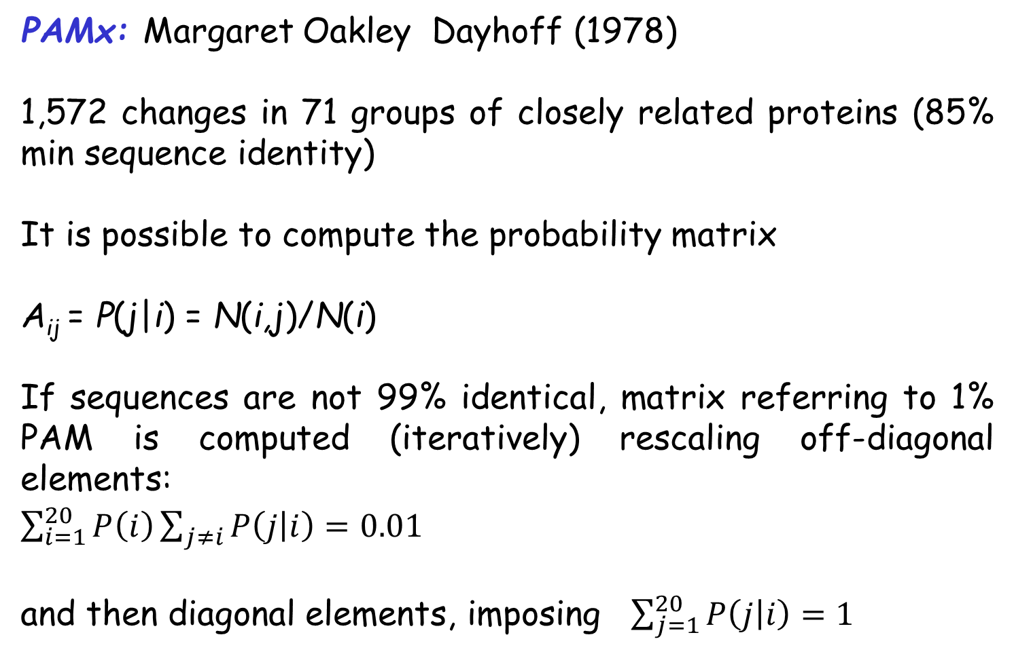
Substitution matrices: PAM
PAMx: Margaret Oakley Dayhoff (1978)
1,572 changes in 71 groups of closely related proteins (85% min sequence identity)
It is possible to compute the probability matrix
A_{ij} = P(j|i) = N(i,j)/N(i)
If sequences are not 99% identical, matrix referring to 1% PAM is computed (iteratively) rescaling off-diagonal elements:
$\sum_{i=1}^{20}{P\left(i\right)\sum_{j≠i}{P\left(j | i\right)}=0.01}$
and then diagonal elements, imposing $\sum_{j=1}^{20}{P\left(j | i\right)}=1$

Slide 42
Substitution matrices: PAM
PAMx: Margaret Oakley Dayhoff (1978)
1,572 changes in 71 groups of closely related proteins (85% min sequence identity)
It is possible to compute the probability matrix
A¹_{ij} PAM1 probability matrix
Score(PAM1) _{ij} = K Log(A¹_{ij} /P_{i}) PAM1 log-odd matrix

Slide 43
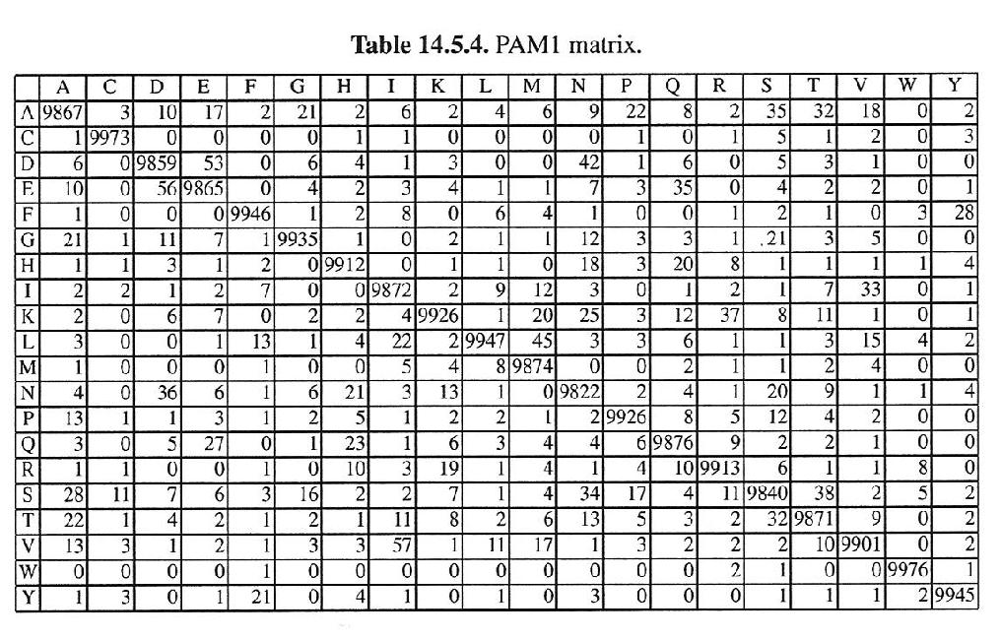
PAM 1 Probability matrix : P(j|i)
(A¹_{ij} x10000)
Very stringent matrix: very low values off diagonal

Slide 44
Substitution matrices: PAM
To derive a score matrix for sequences undergone to n
mutational events every 100 residues:
A^{n}_{ij}=(A¹_{ij})^{n}
n=2 P(i|j) = Π_{l} P(i|l) P(l|j)
The residue j can change into i via any intermediate l
Score (PAMn) _{ij} = Log(A^{n}_{ij} /P_{i})

Slide 45
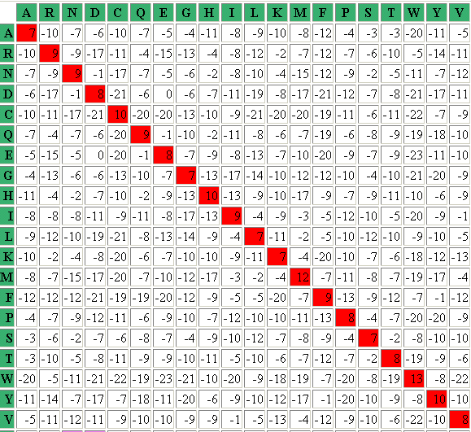
PAM10 log odd matrix
Very stringent matrix: no positive value out of the diagonal

Slide 46
Substitution matrices: PAM
To derive a score matrix for sequences undergone to n
mutational events every 100 residues:
n % mutational events does not mean that n out of 100 residue are different among the two sequences:
as the number of mutational events increases, different mutations can occur in the same position
Then 100 mutational events in a 100-residue sequence leave some unvaried position

Slide 47
Relationship between the PAM and the identity between two sequences
The number of mutational events (PAM) does NOT correspond to the number of different residues between two sequences, when mutations accumulates.

Slide 48
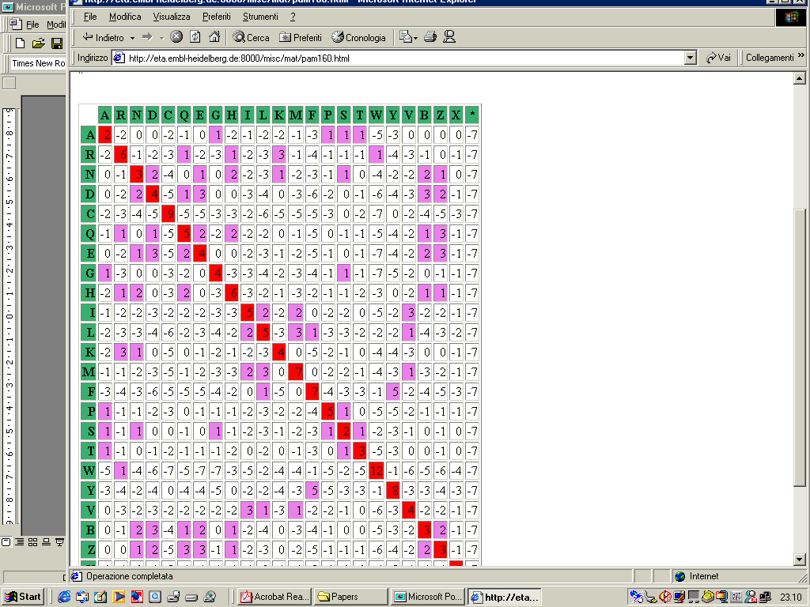
PAM160 log odd matrix
Some positive values out of the diagonal: residue pairs endowed with positive scores are SIMILAR

Slide 49

PAM250 log odd matrix
Often adopted

Slide 50
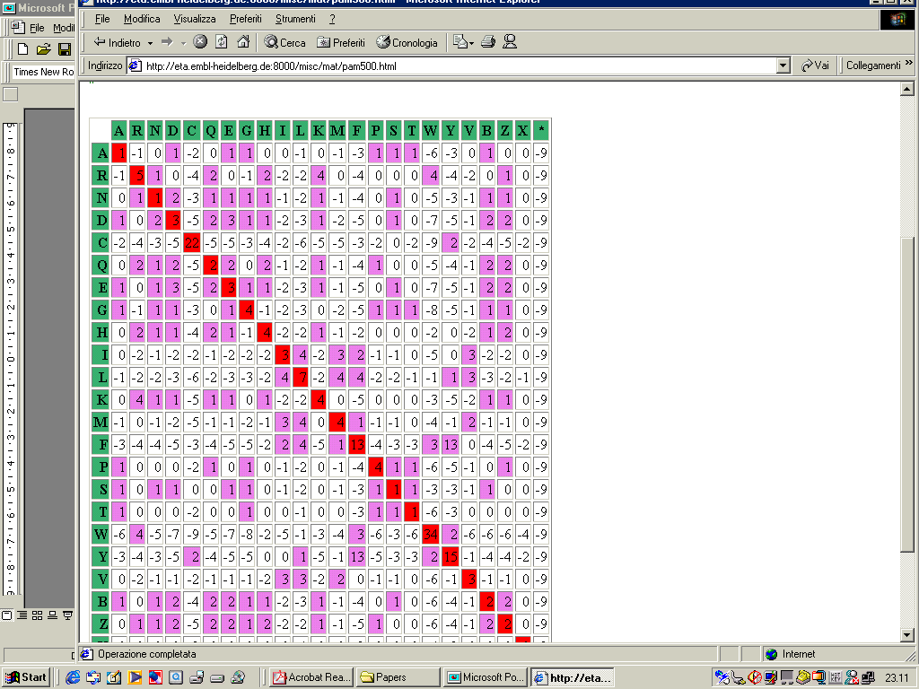
PAM500 log odd matrix

Slide 51
Substitution matrices
PAM matrices are computed under the hypothesis that substitution scores for distant sequences can be derived from the rate of mutation observed in pairs of very similar sequences.
BLOSUMx: BLOck Substitution Matrix (Henikoff and Henikoff (1992)
Family of matrices computed directly starting from curated alignments of sequences with at most x% of identical residues
For highly similar sequences low PAMs or high BLOSUMs have to used. The contrary, for distant sequences

Slide 52
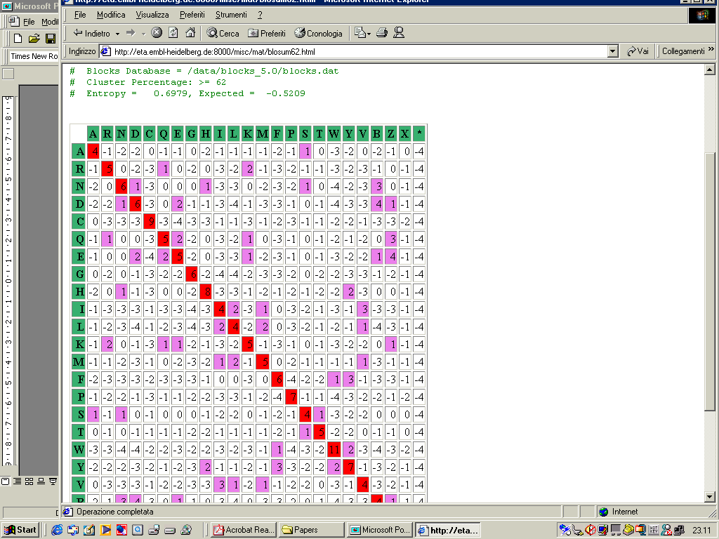
BLOSUM62
Often adopted

Slide 53
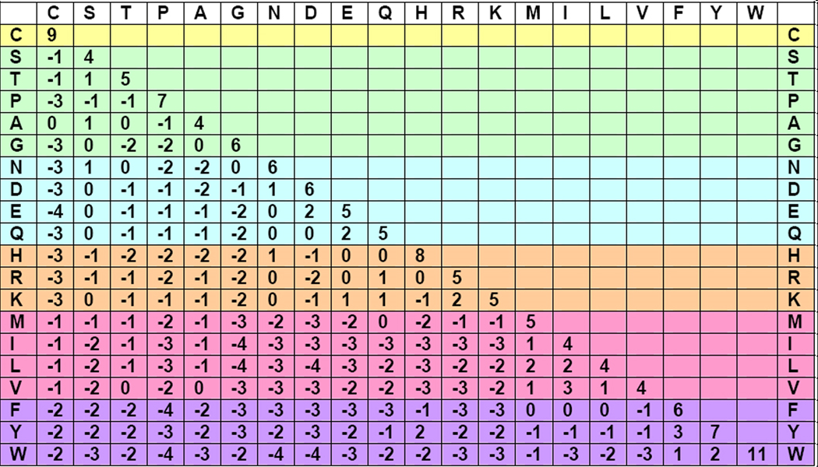
BLOSUM62 Matrix
Small hydrophylic
Acid, acid amide and hydrophilic
Basic
Small hydrophobic
Aromatic

Slide 54
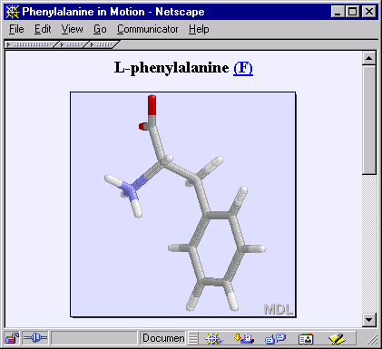
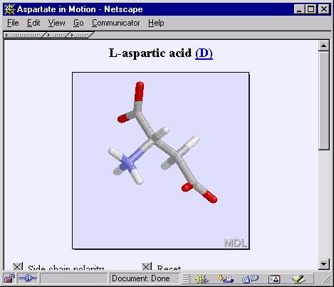
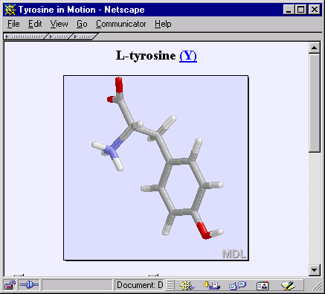
BLOSUM62 Substitution Matrix
Scoring Systems - Proteins
NCBI FieldGuide
A 4
R -1 5
N -2 0 6
D -2 -2 1 6
C 0 -3 -3 -3 9
Q -1 1 0 0 -3 5
E -1 0 0 2 -4 2 5
G 0 -2 0 -1 -3 -2 -2 6
H -2 0 1 -1 -3 0 0 -2 8
I -1 -3 -3 -3 -1 -3 -3 -4 -3 4
L -1 -2 -3 -4 -1 -2 -3 -4 -3 2 4
K -1 2 0 -1 -3 1 1 -2 -1 -3 -2 5
M -1 -1 -2 -3 -1 0 -2 -3 -2 1 2 -1 5
F -2 -3 -3 -3 -2 -3 -3 -3 -1 0 0 -3 0 6
P -1 -2 -2 -1 -3 -1 -1 -2 -2 -3 -3 -1 -2 -4 7
S 1 -1 1 0 -1 0 0 0 -1 -2 -2 0 -1 -2 -1 4
T 0 -1 0 -1 -1 -1 -1 -2 -2 -1 -1 -1 -1 -2 -1 1 5
W -3 -3 -4 -4 -2 -2 -3 -2 -2 -3 -2 -3 -1 1 -4 -3 -2 11
Y -2 -2 -2 -3 -2 -1 -2 -3 2 -1 -1 -2 -1 3 -3 -2 -2 2 7
V 0 -3 -3 -3 -1 -2 -2 -3 -3 3 1 -2 1 -1 -2 -2 0 -3 -1 4
X 0 -1 -1 -1 -2 -1 -1 -1 -1 -1 -1 -1 -1 -1 -2 0 0 -2 -1 -1 -1
A R N D C Q E G H I L K M F P S T W Y V X
Common amino acids have low weights
Rare amino acids have high weights
Negative for less likely substitutions
Positive for more likely substitutions
From NCBI field guides

Slide 55
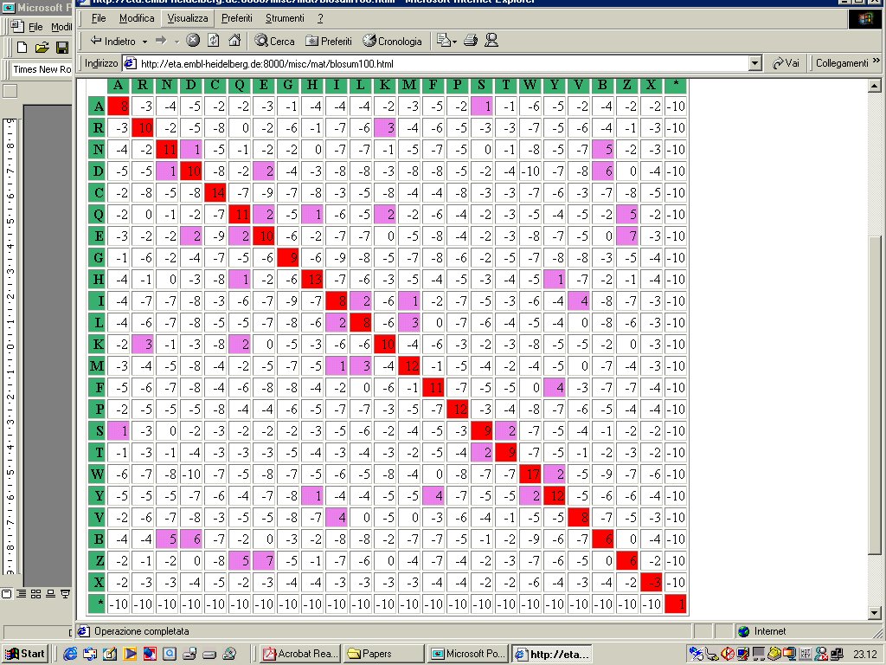
BLOSUM90

Slide 56
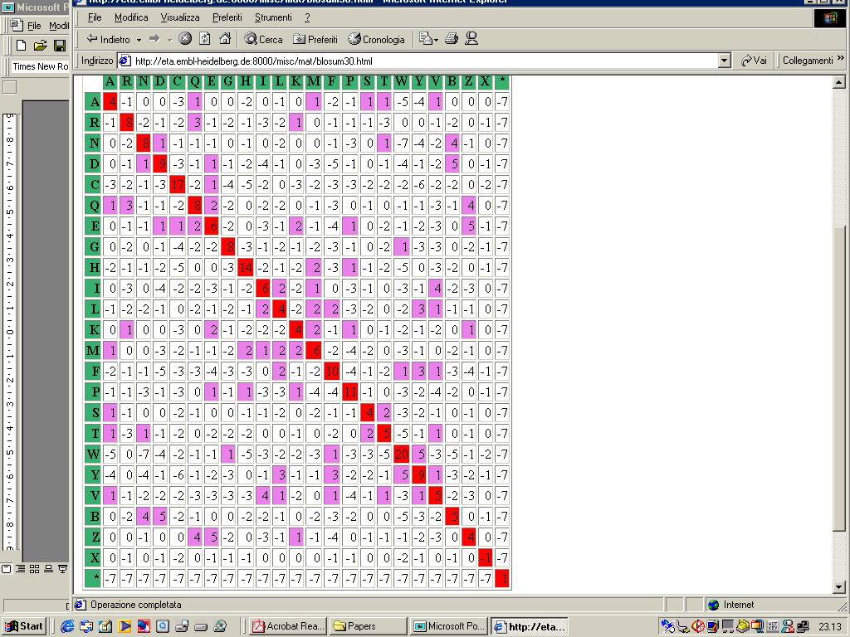
BLOSUM30

Slide 57
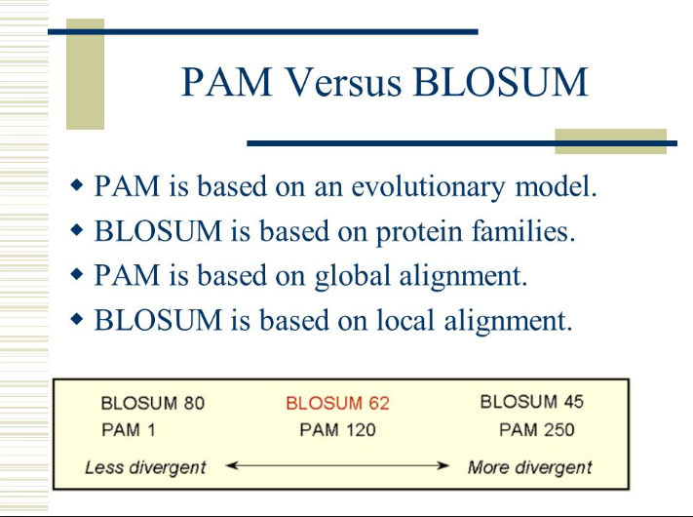

Slide 58
Distance between aligned sequences
Alignment without gaps
A: ALASVLIRLITRLYP
B: ASAVHLNRLITRLYP
The alignment consists of a sequence of paired residues
Defining a score for the substitution of residue i with residue j: s(i,j) [Substitution matrix] ,
the score of the two aligned sequences can be computed as the sum of substitution scores over the alignment length
NB: it assume strong independence among the alignment positions

Slide 59
Distance between aligned sequences
Alignments with gaps
A: ALASVLIRLIT--YP
B: ASAVHL---ITRLYP
Deletion and Insertion
Some residues can be inserted or deleted

Slide 60
Distance between aligned sequences
The gap score is always negative and depends only on its length
Two main possibilities:
LINEAR
σ(n) = -nd (each gapped position is equivalent)
AFFINE
σ(n) = -d - (n-1)e (d: opening, e: extension with d>e)
N.B. All the scores are independent of the position along the sequence

Slide 61
Sequence alignment
Given two sequences, what is the maximal scoring alignment ?
Naïf solution: try all the possible alignments and chose the best scoring
The score of any alignment can be computed with as

Slide 62
How many possible alignments between to sequences?
Write ALL the possible ungapped alignments between the two sequences
A: tca
B: ga
Score the alignments using the following matrix and the linear gap penalty (d=2)

Slide 63
How many possible alignments between two sequences?
Identical to the first
Ungapped
--tca -tca tca tca tca- tca--
ga--- ga-- ga- -ga --ga ---ga
-10 -7 -4 -1 -6
Given two sequences with lengths m and n, the number of shifts is m +n

Slide 64
How many possible alignments between to sequences?
Write ALL the possible gapped alignments between the two sequences
A: tca
B: ga
Score the alignments using the following matrix and the linear gap penalty (d=2)

Slide 65
How many possible alignments between two sequences?
Gapped
--tca -tca -tca -tca t-ca
ga--- ga-- g-a- g--a ga--
gatca gtaca gtcaa gtcaa tgaca
22111 21211 21121 21112 12211
tca tca tc-a tca tca-
ga- g-a -ga- -ga --ga
tgcaa tgcaa tcgaa tcgaa tcaga
12121 12112 11221 11212 11122
The number of possible alignments is equal to the possible ways to intercalatevtwo sequences, preserving the order
Given two sequences with lengths m and n, the number of possible alignments is (m+n)!/n!m!
If n=m=80 there are 9•10⁴² possible alignments !!!!!!!

Slide 66
Solution: to adopt dynamic programming strategies
Needleman-Wunsch
Smith-Waterman

Slide 67
Basic idea of dynamic programming
The complete computation of the alignment scores for all the possible alignments leads to compute the same things many times
ALSKLASPALSAKDLDSPALS
ALSKIADSLAPIKDLSPASLT
ALSKLASPALSAKDLDSPAL-S
ALSKIADSLAPIKDLSPASLT-
The two alignments are equal for most of the length
Scores are summed along the alignment: naif method computes the score for the first part of the alignment is computet two times: BETTER TO STORE AND REUSE IT

Slide 68
Basic idea of dynamic programming
Build the alignment step by step, storing the optimal alignment between substrings
Given the two sequences
ALSKLASPALSAKDLDSPALS, ALSKIADSLAPIKDLSPASLT
the best alignment between the substrings
ALSKLASPA
ALSKIAD
is for sure deriving from one of the following possibilities:
ALSKLASP A ALSKLASP A ALSKLASPA -
ALSKIA D ALSKIAD - ALSKIA D
It is the highest scoring one
+
+
+

